Slide 1
Customer Churn Prediction Using Machine Learning
Nikunj Reddy Porla.
21WU0101030.
Keshava Reddy.
21WU0101043.

Slide 2
Problem Statement
Customer churn is a significant concern for businesses, particularly in industries like telecommunications, where competition is fierce. The problem revolves around predicting which customers are likely to leave a company's services and identifying the factors influencing their decision to churn. The aim of this machine learning project is to develop an effective churn prediction model that can assist businesses in reducing customer attrition.
Project Objective
The project aims to develop a customer churn prediction system using machine learning techniques in the telecommunications industry. The primary objectives are to accurately identify customers at risk of churning, understand the factors influencing churn, and provide actionable insights to mitigate it. We intend to address data quality challenges, handle class imbalance issues, and ensure model interpretability. By achieving these objectives, the project aims to empower businesses to proactively retain customers, enhance customer satisfaction, and optimize their strategies for sustainable growth in a competitive market.

Slide 3
ABSTRACT
In the telecom sector, customer churn poses a significant challenge, with companies striving to identify and mitigate it effectively. This project presents a comprehensive approach to churn prediction and analysis in the telecom industry. It emphasizes the importance of retaining existing customers over acquiring new ones and proposes a multi-faceted model for tackling churn.
The study employs machine learning techniques, including classification and clustering, to identify churn customers and their underlying reasons.
The project identifies critical churn factors, aiding in understanding the root causes of churn. This knowledge empowers customer relationship management to enhance productivity, tailor promotions, and optimize marketing campaigns.
The study also includes a comparative analysis of machine learning methods. This research contributes valuable insights to the telecommunications industry for addressing churn and fostering customer loyalty.

Slide 4
Introduction
In data-driven sectors like telecommunications, understanding and predicting customer churn is paramount. Customer churn, characterized by customers switching from one provider to another, significantly impacts a company's revenue. This phenomenon is especially critical in the highly competitive and technologically advanced telecom industry. Recognizing the drivers of churn, such as high costs, poor service, fraud, and privacy concerns, is essential. Retaining existing customers is recognized as more cost-effective than acquiring new ones. Consequently, businesses in various sectors, including telecom, have sought ways to predict and mitigate customer churn, often relying on historical data and classification techniques. This project explores an updated approach that employs Random Forest, and CNN classifiers to enhance predictive accuracy.

Slide 5
Project Architecture and Framework
Phase 1: Data Preparation: Data Collection, Data Cleaning, Feature Engineering.
Phase 2: Model Development: Data Split, Model Selection, Class Imbalance Handling, Model Evaluation.
Phase 3: Interpretability and Deployment: Interpretable Features, Model Interpretability, Model Deployment
Time Chart:
- Phase 1: Data Preparation (2 weeks)
- Phase 2: Model Development (4 weeks)
- Phase 3: Interpretability and Deployment (Ongoing)

Slide 6
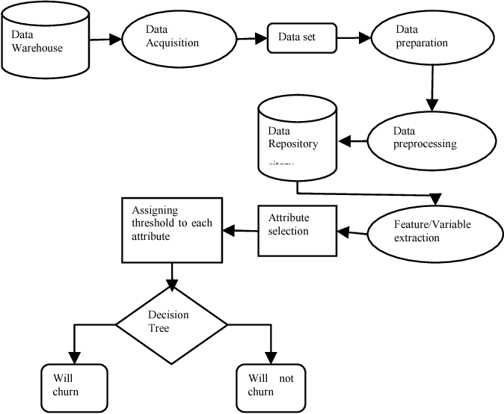
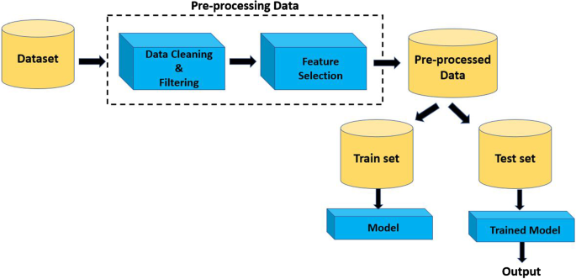
Flow Diagram

Slide 7
Models Implemented
Random Forest Classifier
Artificial Neural Network (ANN)
K-Nearest Neighbors (KNN)
Logistic Regression
Gaussian Naive Bayes
Decision Tree
Support Vector Machine (SVM)
Linear Discriminant Analysis (LDA)
XGBoost

Slide 8
Results
| Model | Accuracy |
| Random Forest | 0.80 |
| Artificial Neural Network | 0.80 |
| K-Nearest Neighbors | 0.77 |
| Logistic Regression | 0.81 |
| Gaussian Naive Bayes | 0.76 |
| Decision Tree | 0.72 |
| Support Vector Machine | 0.82 |
| Linear Discriminant Analysis | 0.82 |
| XGBoost | 0.79 |

Slide 9
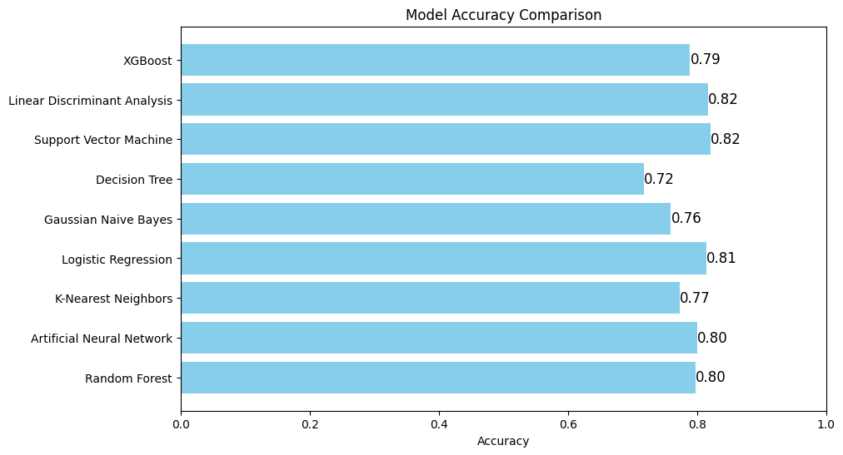
Comparision

Slide 10
References
A Churn Prediction System for Telecommunication Company Using Random Forest and Convolution Neural Network Algorithms. Link: https://eudl.eu/pdf/10.4108/eetmca.v6i21.2181
A Churn Prediction Model Using Random Forest: Analysis of Machine Learning Techniques for Churn Prediction and Factor Identification in Telecom Sector Link: https://ieeexplore.ieee.org/stamp/stamp.jsp?tp=&arnumber=8706988

